Slide 1
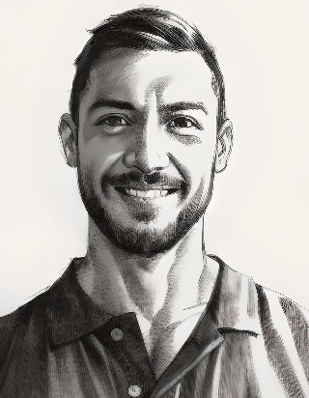
Image to Pencil Sketch
Submitted by Khushi Gupta(2408390109003)
Session: 2025-26
Under Dr. BDK Patro Sir (Associate professor)
CSE Department

Slide 2
Agenda
1
2
3
4
5
Introduction
Steps of Image to pencil sketch
How to get Sketch Image
Advantages and Disadvantages
Summary

Slide 3
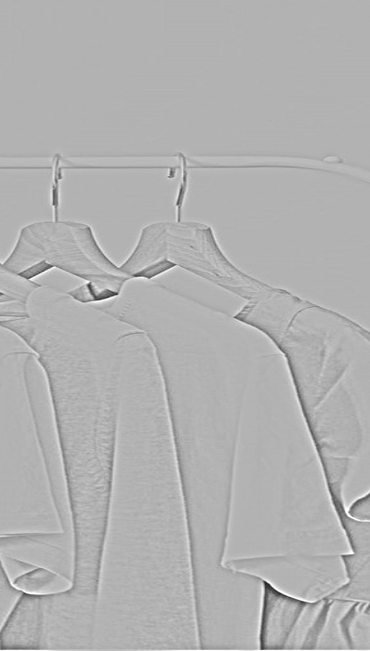
Introduction
Image to Pencil Sketch is a digital image processing technique that converts a color or grayscale photograph into a pencil-drawn style image by highlighting edges, contours, and shading while reducing color details. It is widely used in photo editing, artistic rendering, and computer vision applications. This conversion can be achieved using classical image processing methods such as grayscale conversion, edge detection, and blurring, as well as modern deep learning approaches like convolutional neural networks and neural style transfer for more realistic results. Overall, the technique provides an automated way to transform photographs into visually appealing pencil sketches, combining photography with artistic effects.

Slide 4
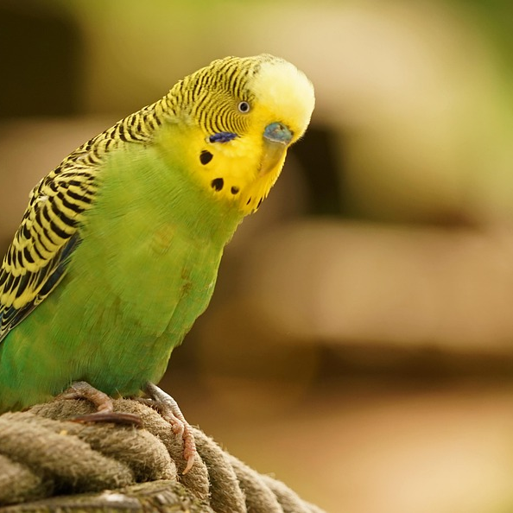
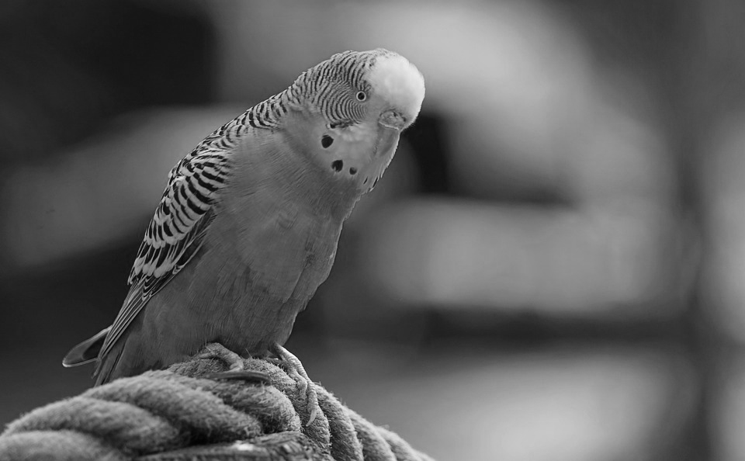

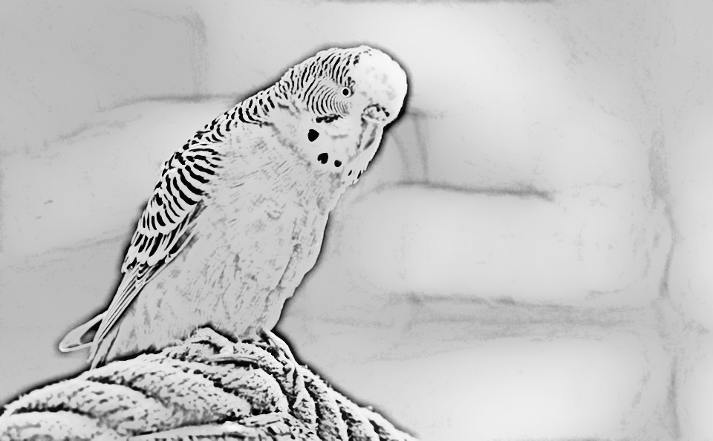
Steps of Image to Pencil Sketch
Step 1:
Input Image
Step 2:
Grayscale Conversion
Step 3:
Image Inversion
Step 4:
Gaussian Blur
Step 5:
Edge Detection / Blending

Slide 5
How we get Sketch​
Input Image​
Gray Scale Conversion
Image Inversion
​
Grayscale conversion transforms a color image into shades of gray.
It reduces image complexity by removing color information.
Each pixel represents intensity instead of RGB values.
It simplifies further image processing operations.
Commonly used in edge detection and image enhancement.
. Image inversion converts each pixel value to its negative intensity.
Dark regions become bright and bright regions become dark.
It is implemented using the formula
s = L − 1 − r, where L is intensity levels.
Helps in enhancing details in dark or low-contrast images.
Commonly used in image processing and medical imaging applications
A digital image (photo) taken from a camera or stored file.
Clear and high-quality images give better sketch results.
Input image can be RGB or grayscale format.
Image is resized, denoised, or converted to grayscale before processing.
Common formats include JPG, PNG, or BMP.

Slide 6
How we get Sketch
Gaussian Blur
Edge Detection / Blending
Pencil Sketch Output
Pencil Sketch Output is a grayscale or near-monochrome image that resembles a hand-drawn sketch.
It emphasizes edges, contours, and fine details while suppressing colors.
The output highlights object structure and shape clearly.
It gives an artistic and simplified representation of the original image.
Commonly used in creative design, photo editing, and image processing applications.
Gaussian Blur is a smoothing technique used to reduce noise and detail in an image.
It uses a Gaussian function to calculate the weighted average of neighboring pixels.
The blur strength depends on the kernel size and standard deviation (σ).
It helps in edge smoothing and reduces high-frequency components.
Commonly used as a preprocessing step in edge detection and image filtering.
Edge Detection identifies object boundaries by detecting sudden changes in pixel intensity.
Gradient-based operators such as Sobel, Prewitt, and Canny are commonly used.
Image blending combines edge maps with grayscale or inverted images using arithmetic operations.
In pencil sketch generation, blending enhances edges while preserving a hand-drawn look.

Slide 7
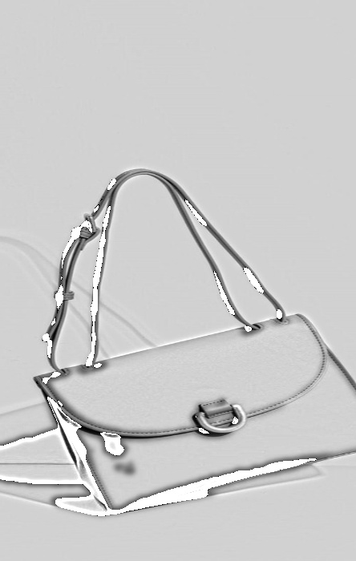
Advantages
It enhances the artistic appearance of images by converting photos into pencil drawings.
It clearly highlights edges and important details, improving visual clarity.
Classical methods have low computational cost and work efficiently.
It is widely used in creative fields such as digital art and graphic design.
It improves feature visibility by removing unnecessary color information.
The method is easy to implement using libraries like OpenCV.
It has high educational value for learning basic image processing concepts.
It can be used as a preprocessing step in computer vision tasks.
Classical techniques do not require large datasets or training.
It is suitable for real-time applications such as camera filters.

Slide 8
Disadvantages
Produces limited realism compared to hand-drawn sketches.
Quality depends heavily on lighting and contrast of the input image.
Cannot capture complex artistic styles.
Results may lose fine texture details.
Sensitive to noise in the image.
Requires manual parameter tuning.
Not suitable for high-level semantic understanding.
Struggles with complex backgrounds.
Output lacks creative variation.
Less accurate than deep learning–based methods.

Slide 9
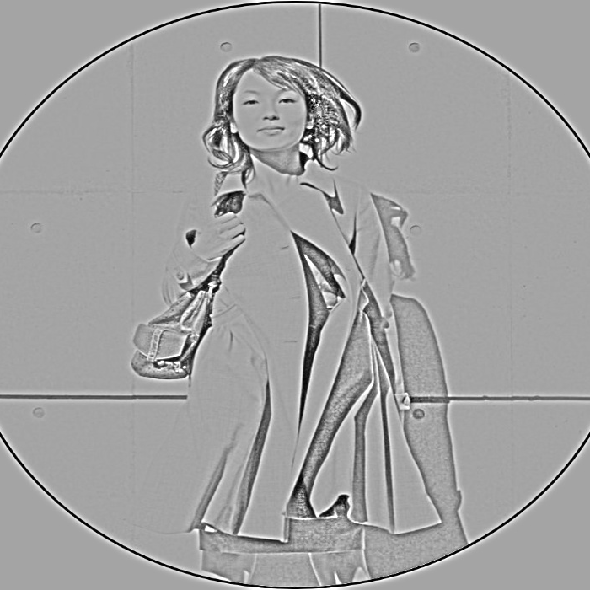
Summary
Image to Pencil Sketch is a technique in image processing that converts a digital photograph into a pencil-drawn style image. It works by transforming the image into grayscale, smoothing it using filters like Gaussian blur, and enhancing edges to highlight important features. This process removes color information and focuses on shapes, textures, and outlines. Classical methods are fast, easy to implement, and do not require training data, making them suitable for real-time and educational applications. Image to pencil sketch is widely used in digital art, photo editing, and as a preprocessing step in computer vision tasks.

Slide 10
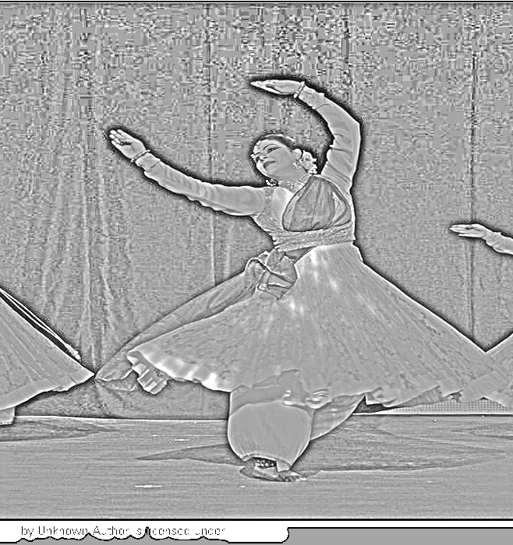
Thank you
Khushi Gupta (Lateral Entry)
Roll No. : 2408390109003
Year : 3rd year
Department of Computer Science Engineering

